Slide 1
Admission Prediction System
Guided By:
Prof. Meiliu Lu
Presented By:
Aaishwary Vadodariya
Anand Rawat
Jaidipkumar Patel
Jay Bibodi

Slide 2

Over-View
Problem Statement
Goals
Data Overview
Data Issues
Data Pre-processing
Model Implementation
Demonstration
Statistical Results & Visual Analysis
Future Enhancement
References

Slide 3

Problem Statement
Problem 1:
Aragon is an International Student who wants to pursue his Masters Degree in the US
He knows the requirements of each college he wants to apply to
He has given all his exams and is now ready to apply
Problem 2:
University of Gondor has close to 1000 applicants for admission
If each application takes 5 hours manually, then the whole set would take close to 5000 hours approximately
This can be avoided by using data of previous admits and rejects.

Slide 4

Goals
University Selection:
To find the probability for a student to get an admit in the university before applying
Student Selection:
To develop a model based on previous years data of the students who got admits or rejects in a particular university

Slide 5

Data
University Dataset for determining university decision
1686 rows with 18 columns
Student Dataset for determining student probability to get admit
10 datasets each containing 50 to 200 records of data.
Work Experience, GRE Score, TOEFL Score, Undergrad University, Name of Student, Result, Major… etc.
Data Source: Facebook Community

Slide 6
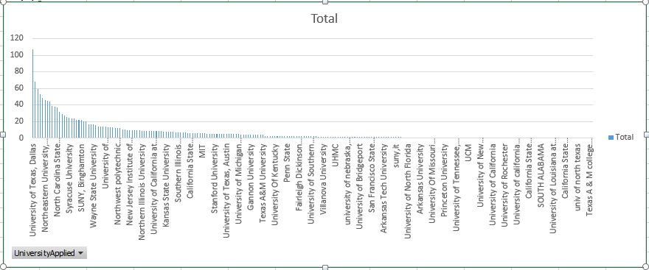

Slide 7

Data Issues
Noisy
Unformatted
Inconsistent
Data Quality
Performance
Data Skewness
Notes:
Data Skewness
Unformatted (Incompatible datatypes)
Performance (Deteriorate without pre-processing)
Data Quality: lacking attribute values, lacking certain attributes of interest, containing only aggregate data.
Noisy: containing errors and outliers
Inconsistent: Containing discrepancies in codes and names

Slide 8
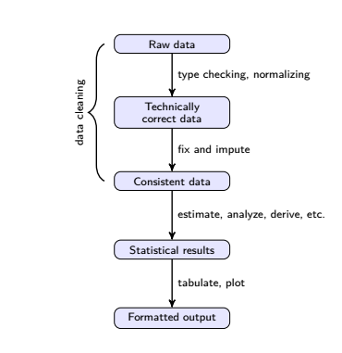
Data Pre-Processing
Data Cleaning
Raw Data
Technically correct data
Consistent data
Feature Scaling
Statistical Results

Slide 9
Details
Result, GRE, AWA, TOEFL and Percentage are the columns, based on which the Student Selection model is designed
Using mean of the values for missing values of AWA and TOEFL.
Changing categorical data to numeric value.
Ignoring record for percentage is not present.
GRE, AWA, TOEFL and percentage are columns based on which model is designed for getting probability of student getting admit to university.
Same as above except second point.
Feature Scaling of all the column used to design model except Result column.

Slide 10
Models

Slide 11
Model Implementation
Naïve Bayes → e1071
SVM Linear → e1071
SVM Kernel → e1071
Decision Tree → tree
Random Forest → randomForest

Slide 12
University Selection Model
STUDENT DATA
Model 1
Model 2
Model 3
Model 10
Prediction 1
Prediction 2
Prediction 3
Prediction 10

Slide 13
Demonstration

Slide 14
Statistical Results & Visual Analysis

Slide 15
University Selection
Probability for student to get an admit in the university before applying to it
 | X1 | X2
MTU_pred | 0.96610169 | MTU
clemson_pred | 0.90909091 | Clemson
NE_Boston_pred | 0.82608696 | NE_Boston
ASU_pred | 0.82352941 | ASU
IITchicago_pred | 0.80000000 | IITchicago
RIT_pred | 0.76923077 | RIT
UTD_pred | 0.21296296 | UTD
UTA_pred | 0.18867925 | UTA
UNC_pred | 0.18421053 | UNC
U_southern_cal_pred | 0.08163265 | U_southern_cal

Slide 16
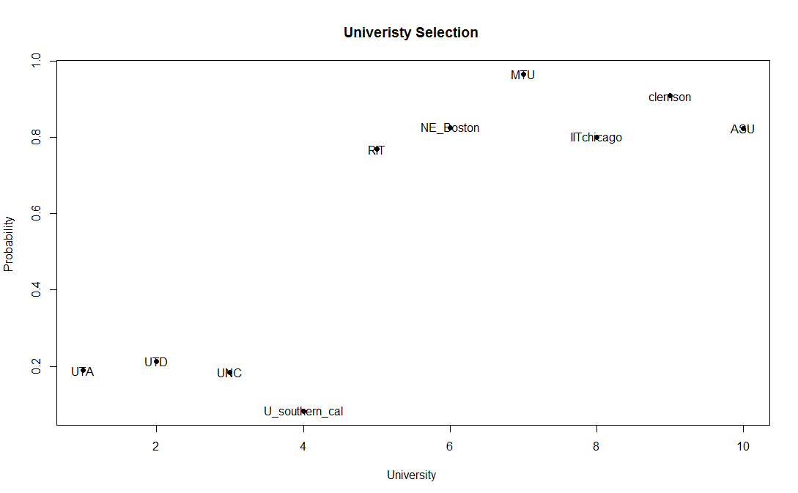
naïve Bayes
Probability Chart using Naïve Bayes

Slide 17
Student Selection
Past Years Data
Pre-Processing Techniques
Machine Learning Models
Predictions
Rejects
New Applicants
Models
Admits

Slide 18

Naïve Bayes
Confusion Matrix
 | 1 | 0
1 | 67 | 6
0 | 18 | 108
$$\text{Error} \text{Rate} =12.06\%$$

Slide 19

SVM-Linear
Confusion Matrix
 | 1 | 0
1 | 69 | 4
0 | 21 | 105
$$\text{Error} \text{Rate} =12.56\%$$

Slide 20

SVM-Kernel
Confusion Matrix
 | 1 | 0
1 | 63 | 10
0 | 16 | 110
$$\text{Error} \text{Rate} =13.06\%$$

Slide 21
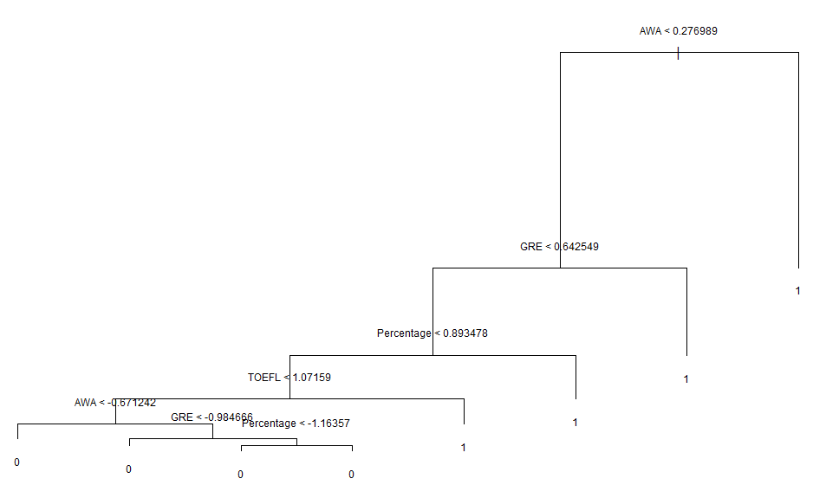
Decision Tree

Slide 22

Decision Tree
Confusion Matrix
 | 1 | 0
1 | 59 | 14
0 | 8 | 118
$$\text{Error} \text{Rate} =11.05\%$$

Slide 23
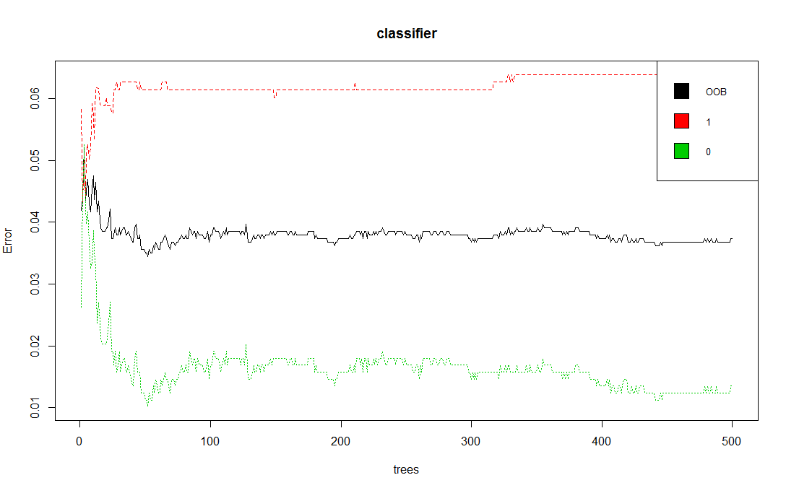
Random Forest
Number of Tress vs Error Rate
Optimal between 60 – 100
We choose 70
Legend
0 – Rejects Error
1 – Accepts Error
OOB – Out-of-bag Error

Slide 24

Random forest
Confusion Matrix
 | 1 | 0
1 | 62 | 11
0 | 10 | 116
$$\text{Error} \text{Rate} =10.55\%$$

Slide 25
Demonstration

Slide 26
Learnings
Data Pre-Processing is vital to the accuracy of the models
Choosing appropriate machine learning techniques and algorithms to model the system
Graphical representation of the data provides useful insights and can lead to better models
Defining scope with respect to the dataset

Slide 27
Future Enhancement
Creating the model with additional parameters such as Work Experience, Technical Papers Written, and Content of Letter of Recommendation etc.
Creating a model based on the graph of admitted vs enrolled students of previous years to predict the increase or decrease in cutoff scores among applicants
Comparing different universities based on applied vs admitted data

Slide 28
References
Discussion Paper:
A Introduction to data cleaning with R Statistics Netherlands, Henri Faasdreef 312, 2492 JP The Hague, www.cbs.nl
A meta-analysis of research in Random Forest for Classification Published in: Pattern Recognition Association of South Africa and Robotics and Mechatronics International Conference (PRASA-RobMech), 2016
Date of Conference: 30 Nov.-2 Dec. 2016, Publisher: IEEE
Web Links: as seen on May 5th 2017
https://cran.r-project.org/doc/contrib/de_Jonge+van_der_Loo-Introduction_to_data_cleaning_with_R.pdf
https://cran.r-project.org/web/packages/e1071/e1071.pdf
https://www.usnews.com/education
http://athena.ecs.csus.edu/~mei/219/csc219.html

Slide 29
Questions, Any?

Slide 30
Fin.

